Slide 1

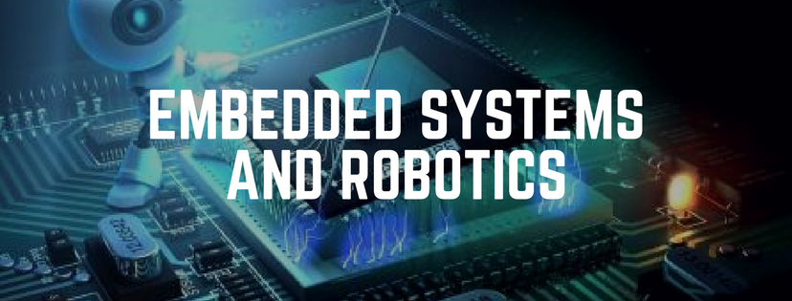
Welcome to the Industrial Training on
IoT Robotics
and Embedded system

Slide 2
Why you should learn IoT Robotics
and Embedded System?
IoT is very crucial in the development of the technology environment because it brings about a huge shift in our professional and personal lives.
Be in demand - With 13 billion+ IoT devices already in use and more being added every second, the demand for IoT Engineers is increasing exponentially.
A multi-disciplinary field and basket of job opportunities
Entrepreneurship
And do you know that Avg. Salary of an IoT, Robotics and Embedded Developer is about $106,528 PA.

Slide 3
Training Highlights
Language: English
Guided Learning Hour: 20-25 hours.
Commitment Per week: 4 hours per week
Training mode- Live online classes (learn from home and Stay safe)
Course Prerequisites- It is Beginner friendly so no prior knowledge required.
Doubt clearing Through email at support@inmovidu.com
+91 8296507779 - for Any support queries
Learning Objectives: Project based learning of Embedded system, Robotics and IoT.
No Hardware is required.
Downloadable content will be provided

Slide 4
Introduction to class | Introduction to Embedded C programming using Arduino | Working with software and Simulation Environment
Software and Hardware Terminology What is IoT and Embedded System? Different devices used for Embedded System | Arduino Uno Architecture Basics of Embedded C programming for Arduino Setup the IDE, Writing Arduino Software Arduino Libraries | Playing with the GPIO pins of the Arduino Uno Testing of electronics component Automatic Function of Arduino Uno to Blink LEDs Alternate LEDs(2) Traffic Light Control
Hardware Communication | Concept of Pulse Width Modulation For loop | Sensor Interface and working
SPI communication UART communication I2C communication Manual Function of Arduino Uno to control LED Combining Manual and Automatic Control of LED | Basic of signal processing Controlling Brightness of an LED without For Loop Controlling Brightness of an LED with For Loop | Overview of Sensors working Analog and Digital Sensors Interfacing of Humidity, Motion, Light and Gas Sensor with Arduino Temperature using DHT11 Interfacing of Actuators with Arduino. Interfacing of Relay Switch and Servo Motor with Arduino Automatic room temperature control system

Slide 5
Implementation on Arduino | What is Robot? | Motion of robot
Projects on Arduino UNO board GPIO pins Sensor interface Communicating device: Bluetooth sensor | Introduction of Robot Types of Robot Future of Robot Industrial applications Domestic applications Commercial applications | What are Motors? Using Motors with Arduino Usage of Motor Drivers -L293D Mini Project: Controlling RC Car
Robotics capstone project | Introduction to IoT | IoT Network
Obstacle avoidance robot line following robot | History of Internet Difference between IoT Device and Embedded Device IoT Case Study Selection of IoT Board Cloud and Analytics | Introduction to SDN Introduction to CCN with connected car Other protocol

Slide 6
IoT and Cloud Platforms | Android App Development using MIT App Inventor | Dashboard and Feeds Creating Applets using IFTTT Google Assistant Project
Using Thingspeak HTTP Protocol: GET and POST Method Write and Read API | Speech to Text Conversion Retrieving Cloud Value and Visualization on App HTTP Request and Response Visualization IoT application | Publishing value on Adafruit Server Creating a simple Applet IoT LED Lamp using Google Assistant and Adafruit Feeds and Dashboards
Wireless protocol basic and Characteristic | Dashboard and Analytics | Node-RED From Idea to prototype
Install and configure MQTT broker Program publish/subscribe simple programs on cloud server | Grafana and InfluxDB Creating Covid 19 dashboard | Understanding Node.js, Node-RED and executing some basic program

Slide 7
IBM Cloud platform | Introduction to Python | Computer vision on RaspberryPi
IBM IoT Watson platform Sensor simulator Working with Open Weather API | Variables, Datatypes Functions and Parameters Libraries, Integrating button in Node red with python code. | Surveillance camera using IoT
Socket Programming | Major Project | Node-RED From Idea to prototype
Server and Client | Discussion and Doubt Clearing

Slide 8
Internet of Things

Slide 9
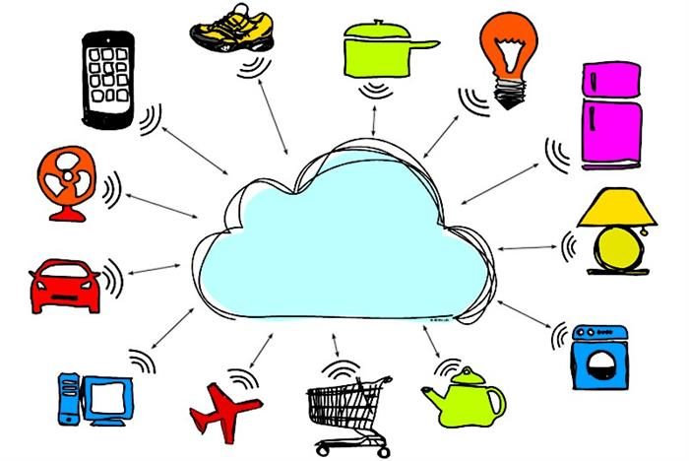

Slide 10
INTERNET

Slide 11
Why do we use Internet?
Social Networking
Information Accessing
Services

Slide 12

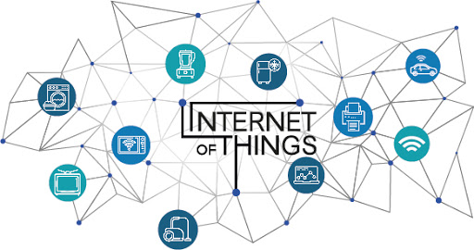
What is IoT?
The network of physical objects—a.k.a. "things"—that are embedded with sensors, software, and other technologies for the purpose of connecting and exchanging data with other devices and systems over the Internet.

Slide 13
Application of IoT
Building and Home Automation
Manufacturing
Medical and Healthcare system
Media
Environmental monitoring
Infrastructure management
Energy Management
Better quality of life for elder people.

Slide 14
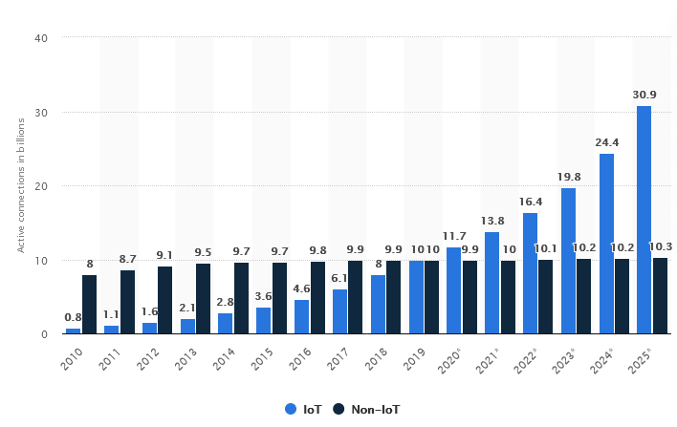
Internet of Things (IoT) and non-IoT active device connections worldwide from 2010 to 2025

Slide 15
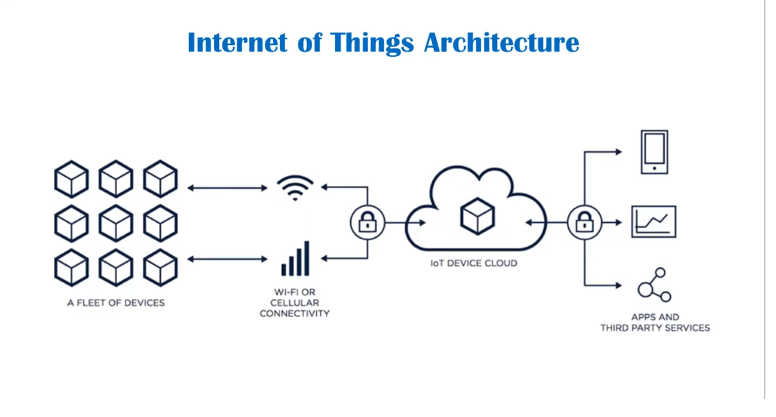

Slide 16
Embedded System- Base of IoT
COMBINATION
OF
HARDWARE + SOFTWARE
INPUT
PROCESS
OUTPUT

Slide 17
Embedded Systems
"It is a combination of hardware and software to perform a specific task"
“An embedded system is a computer system with a dedicated function within a larger mechanical or electrical system, often with real-time computing constraints. It is embedded as part of a complete device often including hardware and mechanical parts. Embedded systems control many devices in common use today.”

Slide 18
Components of Embedded Systems
Power Supply
Processor
Memory
Timers & Counters
Communication Ports
Input & Output
Application Specific Circuits
Software Components
Power Supply
Processor
Display Device
Buzzer for Alert
Device Drivers
MEMS devices
UART
CAN
SPI
I2C
USB
Ethernet
RS-232
RS-423
RS-485
UART
I2C
SPI
Read-Only memory(RAM)
Random Access Memory(ROM)
Electrically Erasable Programmable Read-Only Memory (EEPROM)
Speed
Unit Price
Packaging
Performance
Peripheral Set
Timer on the Chip
Operating Voltage
Number of I/O Pins
Power Consumption
Amount of RAM and ROM
Specialized Processing Units
Architecture 8-bit, 16-bit, or 32-bit
Stable & Smooth Output
Proper Output Current to Drive the Load
Perfect Power Efficiency
Stable in Different Temperature Range
Proper Noise Filtering
Proper Decoupling
Line Regulation changes
Load Regulation – Fluctuation in output voltage when load current changes
Efficiency
Input/Output Ripple Voltage
Transient Response
Allowable Dissipation
Assembler
Emulator
Debugger
Compiler

Slide 19

a few points to remember…
ANALOG
DIGITAL

Slide 20
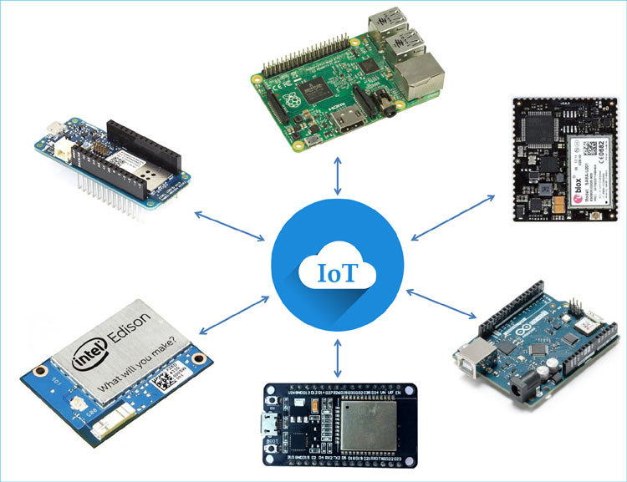
Popular Embedded system devices for IoT

Slide 21

Getting Started with Tinkercad
Tinkercad is a free an easy to use circuit simulating platform.
It is an web based platform
Tinkercad Circuits allows anyone to virtually create and program Arduino projects without the need for physical hardware.
Link: https://www.tinkercad.com/

Slide 22
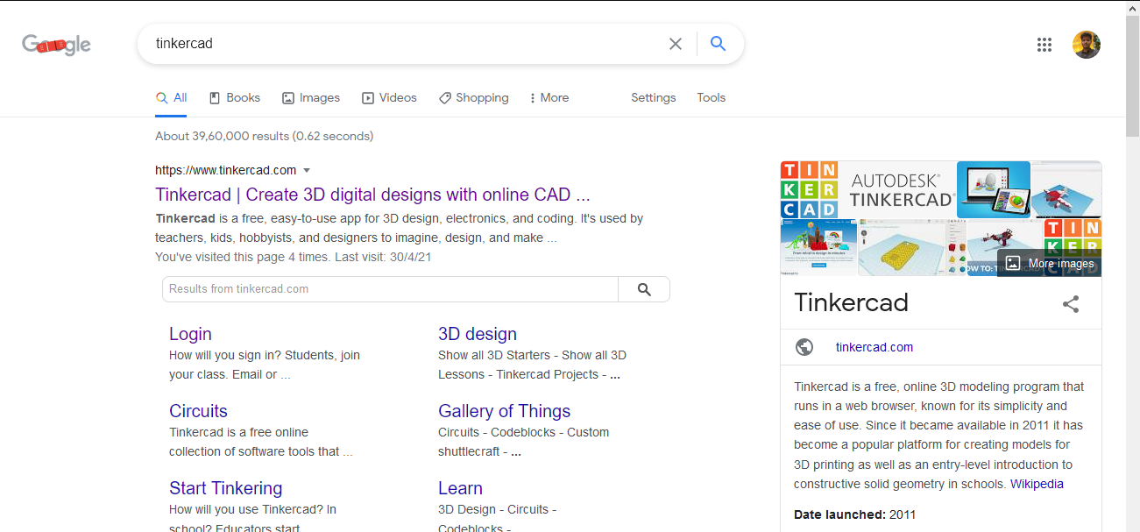

Slide 23
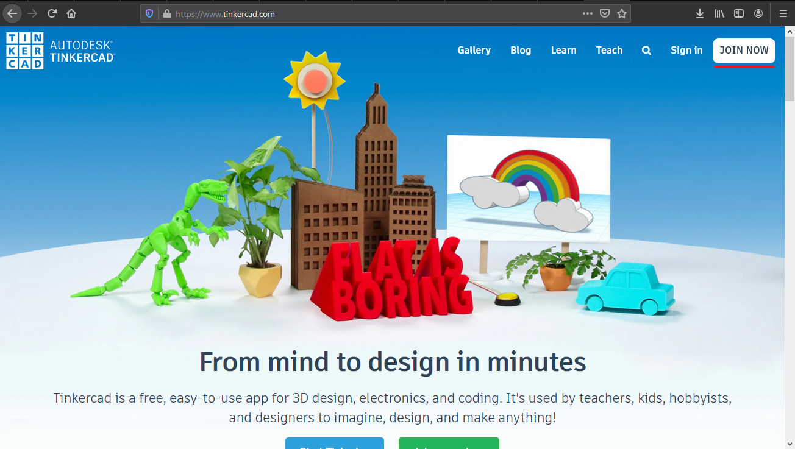

Slide 24
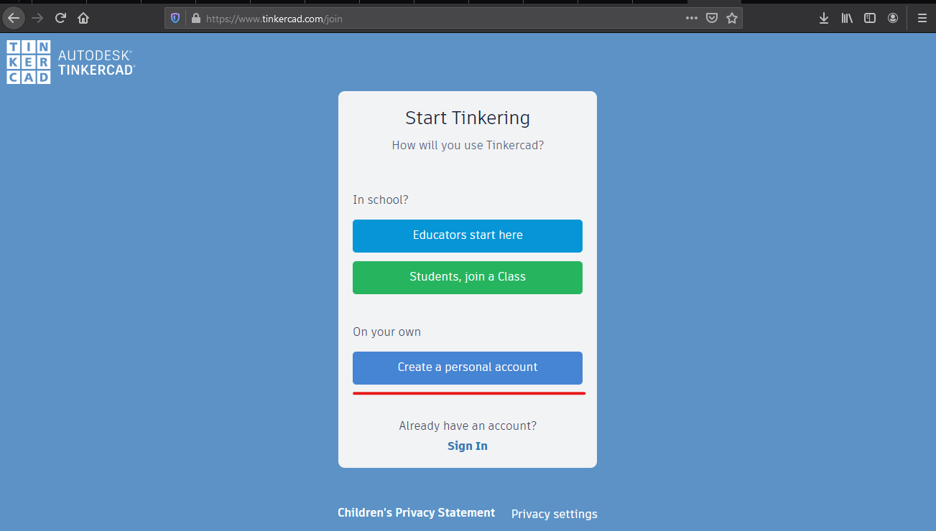

Slide 25
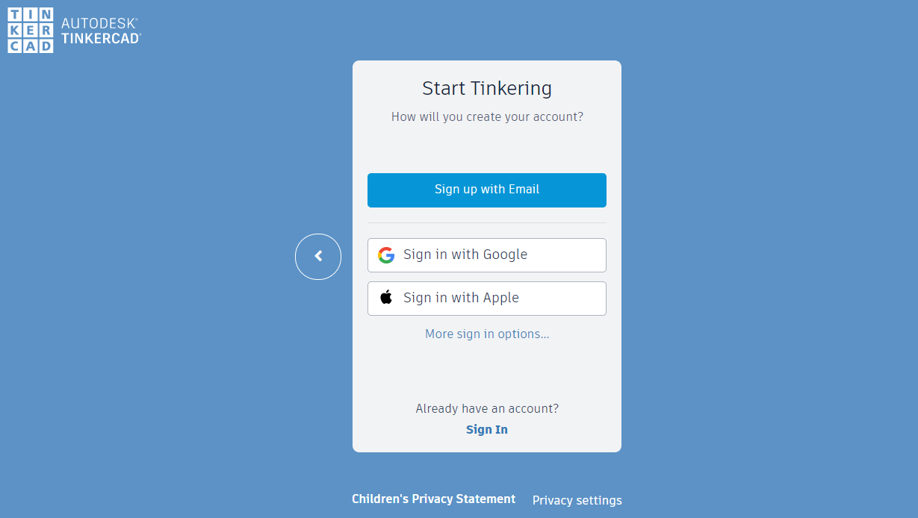

Slide 26
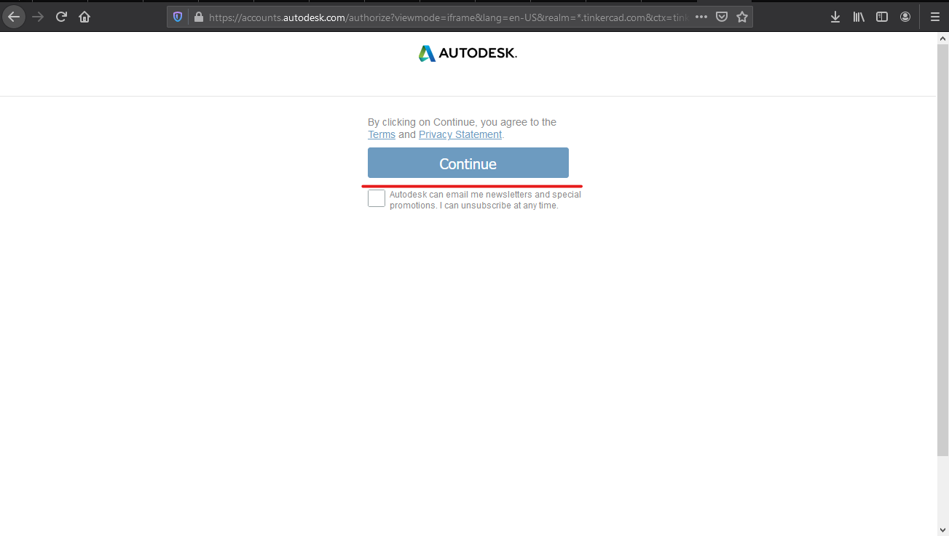

Slide 27
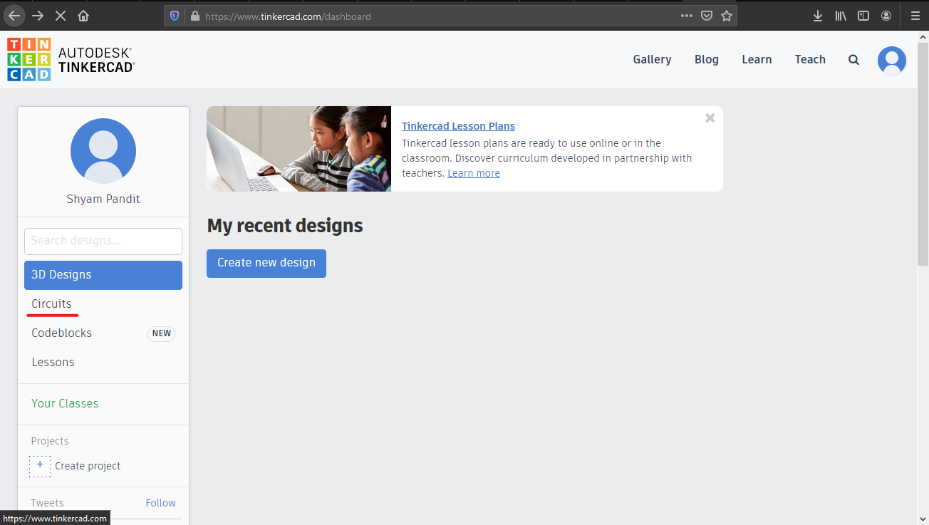

Slide 28
RESISTORS
Resistors are used to limit current or divide voltage and in some cases, generate heat.
Used for driving circuit which requires low current and voltage than available.
A two terminal non-polarised component.

Slide 29
Contd…
Unit of resistance is ohm.
Notation for resistance
O- for ohm
K- for kilo ohm
M- for mega ohm

Slide 30
Physical appearance

Slide 31
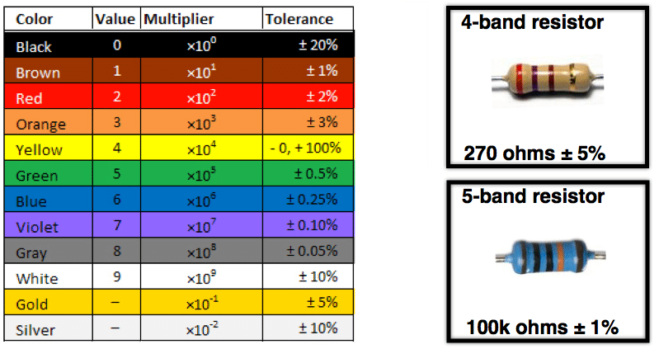

Slide 32
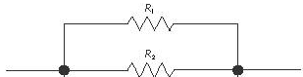
Practical Use….
To reduce the current flowing in circuit, use resistance in parallel.

Slide 33
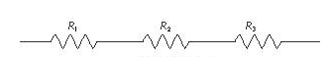
To reduce the voltage for any circuit, use resistance in series.

Slide 34
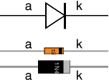
DIODES
A two-terminal electronic component that conducts electric current in only one direction.

Slide 35
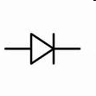
The direction of arrow shows the only possible direction of current.

Slide 36
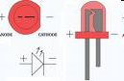
Types of diodes
LED i.e Light Emitting Diodes
These diodes emit light when provided with power supply.

Slide 37
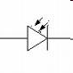
Photodiode
These diode generates currents when exposed to light.

Slide 38
Practical use
Used as a switch
LED as indicators
Photodiodes as light detector

Slide 39
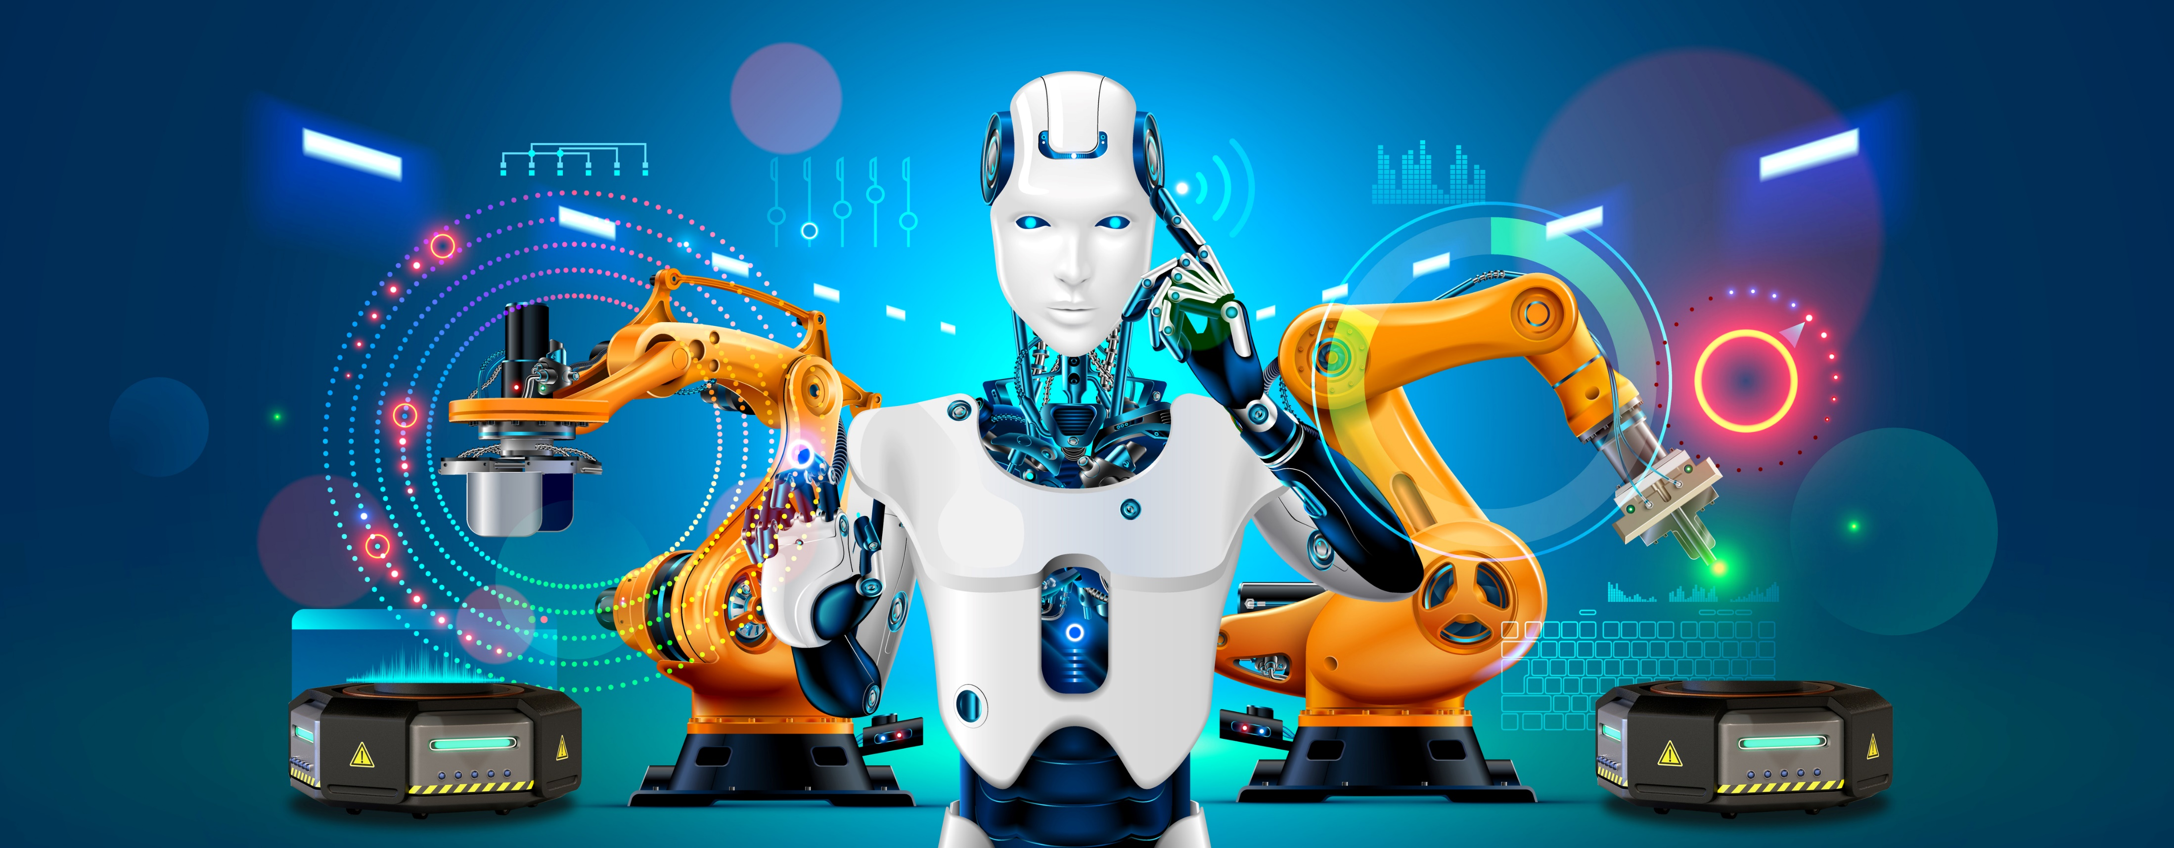

Slide 40
3 Laws of robotics by Isaac Asimov
A robot may not injure a human being or, through inaction, allow a human being to come to harm.
A robot must obey orders given it by human beings except where such orders would conflict with the First Law.
A robot must protect its own existence as long as such protection does not conflict with the First or Second Law.

Slide 41
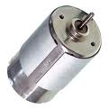
DC Motor
It Contains 2 Terminal
3 states- Clockwise, Anticlockwise and stop

Slide 42
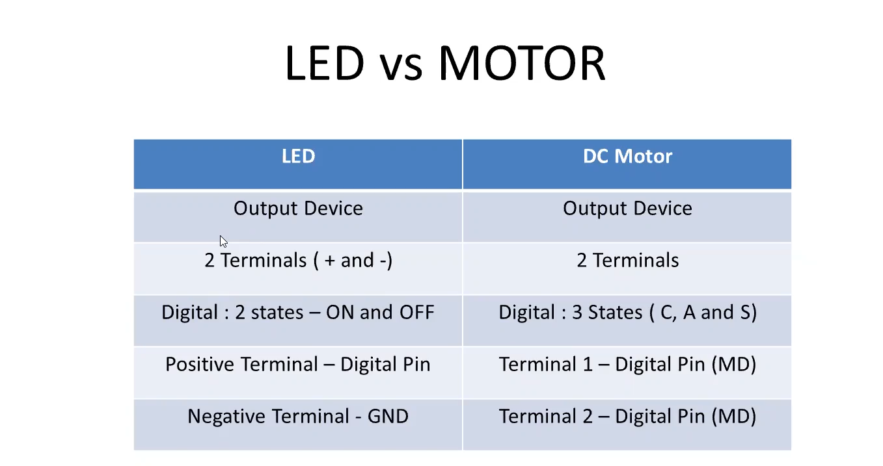

Slide 43
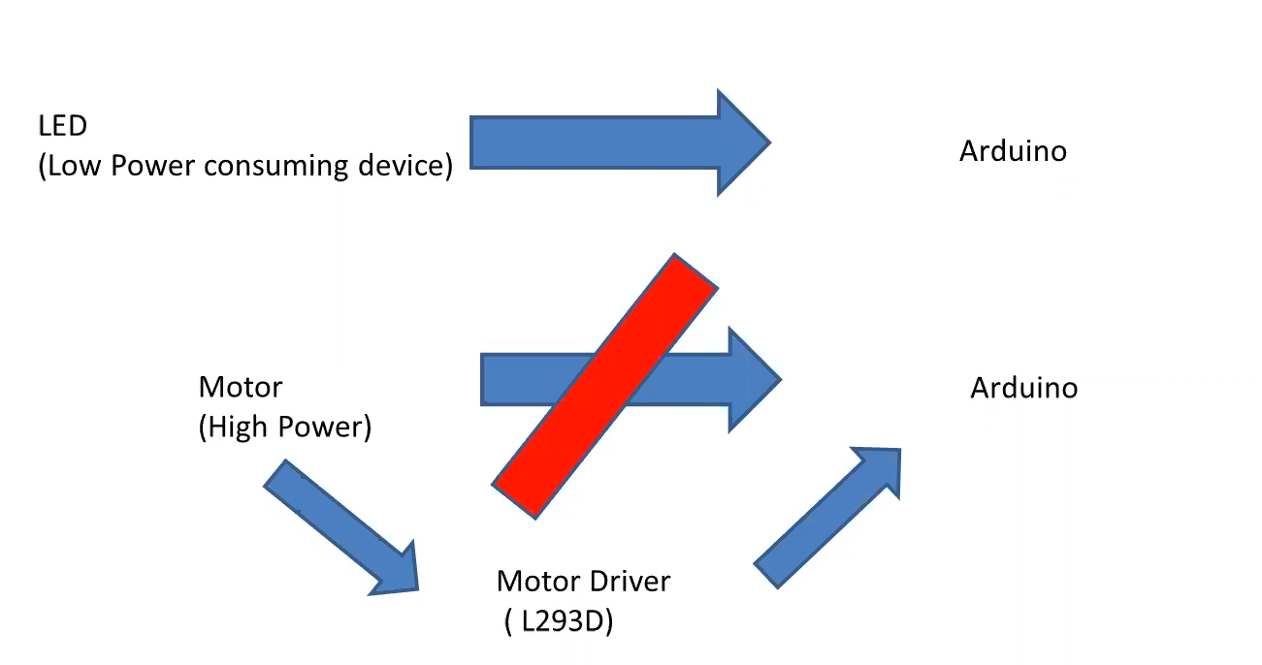

Slide 44
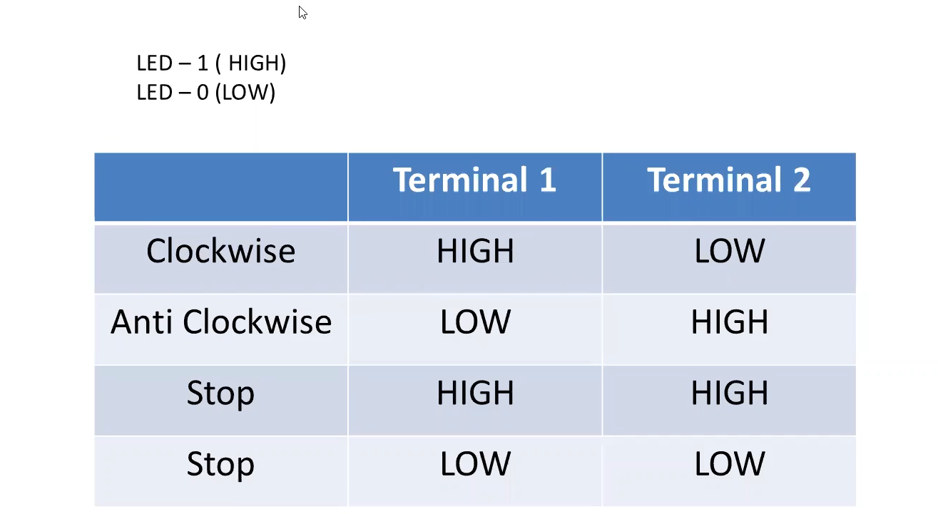

Slide 45
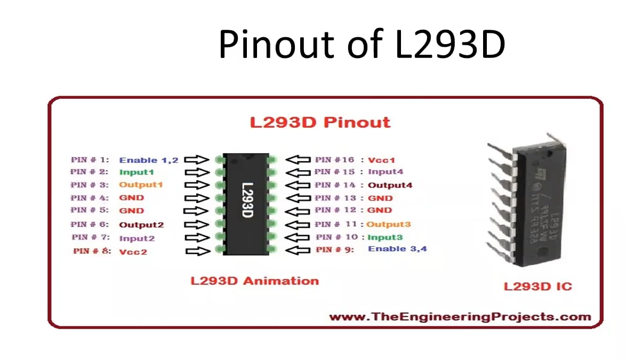
DC Motor

Slide 46
Remote Controlled Car (Based on two motors)
Controlling the car from Serial Monitor--Tinkercad
Controlling the car from mobile app—Bluetooth (Optional)

Slide 47
2 motors—backside of the chassis 1) Forward (clockwise)
2) Backward (anticlockwise)
3) Right
4) Left
5) Stop
1 castor ball (Balancing wheel)

Slide 48
ROBOT’S MOVEMENT (Anti- Forward, Clock-Backward)
LEFT MOTOR RIGHT MOTOR
FORWARD F F
BACKWARD B B
LEFT S F
RIGHT F S
STOP S S

Slide 49
LEFT MOTOR RIGHT MOTOR
LEFT STOP FORWARD
LEFT BACKWARD FORWARD
LEFT FORWARD (SLOW) FORWARD(FAST)

Slide 50
Create a robotic car to be controlled by serial monitor commands
Commands taken should be in the form of String
It should contain 2 motors
Consider Clockwise as forward and anticlockwise as backward
Commands
--FORWARD
--BACKWARD
--RIGHT
--LEFT
--STOP

Slide 51
COMPONENTS :
Arduino Uno
Arduino Uno USB Cable
L293D Motor Driver board
DC Motors -2
Castor Wheel
Chassis
Wheel
Jumper Cables
BlueTooth HC05 (4 pins, STATE and KEY not included)
Powerbank

